Slide 1
Natural Disaster
Data Analytics Programming proposal
Babita Chaini
Sasikumar Jayapal
Sangeeta Kumari
Sai Manoj Thirunahari

Slide 2








Design Architecture
Death toll by disaster/Risk countries
Risk countries/death toll by disaster
Master_Disaster_Event
US Disaster data
US_Disaster_Event
volcano data
US_Volcano_Event
Earthquake
US_Earthquake_Event

Slide 3
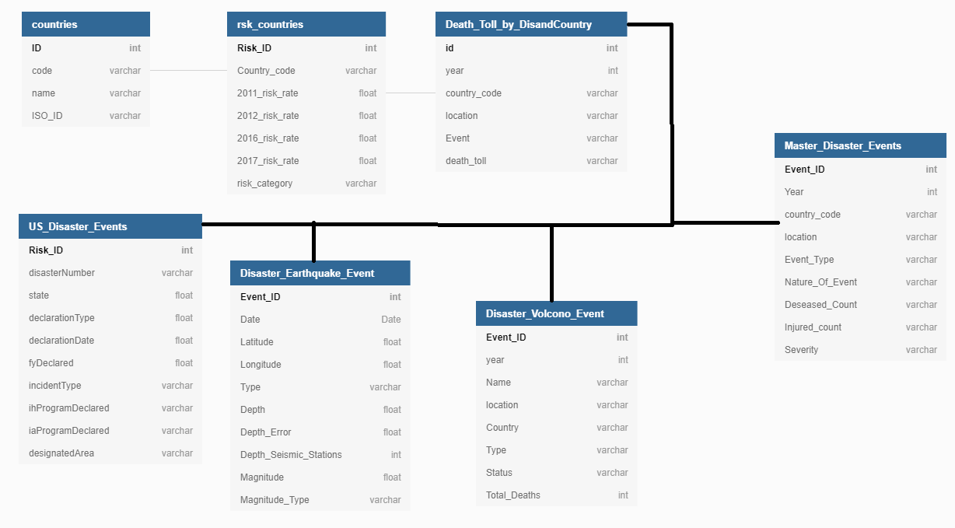
Data Model

Slide 4
Death toll by Disaster/severity perdition
Data Sets:
https://en.wikipedia.org/wiki/List_of_countries_by_natural_disaster_risk
https://en.wikipedia.org/wiki/List_of_natural_disasters_by_death_toll
Data Extraction method:
Web Scraping
Research questions:
Demonstrate the death tolls of each country by disaster.
Predicting the risk countries by risk rate of the previous years.
Tables Used:
US_Disaster_Events
Risk_Countries
Death_Toll_by_DisandCountries

Slide 5
Disaster risk prediction in the US states
Data Sets:
https://www.fema.gov/api/open/v1/FemaWebDisasterDeclarations
Data Extraction method:
API
Research questions:
To find the states in US with maximum disaster risk by analysing the occurrence of disasters over the course of time.
To determine whether individual assistance or housing assistance was provided or not during the disaster.
Tables Used:
US_Disaster_Events

Slide 6
Dataset:
1. https://www.Kaggle.com/datasets/perkymaster/volcano
2. https://www.kaggle.com/datasets/usgs/earthquake-database?select=database.csv
Research Questions:
1. Demonstrating the death troll and total economic damage caused due to volcano disaster.
2. For earthquake dataset, will be discovering through magnitude impact of earthquake how much area being impacted in KM and getting the location details with time and year wise.
Table Used:
Disaster_Earthquake_Event
Disaster_Valcano_Event

Slide 7
To determine top 10 countries that are less chance of disasters
To determine top 10 countries that are high chance of disasters
To show the course of disaster of the countries in the high risk category.

Slide 8
Remove unwanted features
Fixing missing values
Encoding features
Exploring Data
Feature selection

